Slide 1

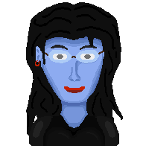


?
?
Ed Room
Tmp Room
Edwige Room
Edna Room
?
?
Bathroom
Humans corridor
Laundry
Bathroom
Green
Purple
Blue
Study
?
?
Infirmary
Tentacles corridor
Suites corridor
Tech Room
Art Room
Music Hall
Arcade Room
Gym
Living room
Upstairs
Corridor
Service room
Dining room
Kitchen
Main Hall
Longue
Library
?
Front door
Start area
?
Underpassage
Dungeon
Basement
Lab Entrance
Secret Lab
Meteor
Garage
Look up
Pool
Barbecue
Court
Patio
Backyard
Shelter
Greenhouse
Woods
Cemetery

